Slide 1
Issues in Cloud Computing

Slide 2
Agenda
Issues in Inter-cloud, environments
QoS, Monitoirng
Load balancing
Dynamic configuration
Resource optimization
Grid, Sky Computing
Middleware

Slide 3
Inter-cloud Challenges
Multi-Cloud
Serial or simultaneous use of services from diverse provider
Hybrid Cloud
Coordinated use of cloud service services across isolation and external cloud services.
Federated Cloud
Cloud provider sub-contracts capacity from other providers and also offer sparse capacity to a federation of cloud providers.
Multi-cloud scenarios-criteria
Decision actor and decision time
Decision actor determines whether the decision to use diverse cloud is taken by cloud provider or broker or user.
Decision time classifies the application deployment at a time

Slide 4
Inter-cloud Challenges
Multi-Cloud setup challenges
Scalability and wide resource availability
Cost efficiency and energy savings
Avoid vendor lock-in
Federated to reduce latency and other legal constraints, availability

Slide 5
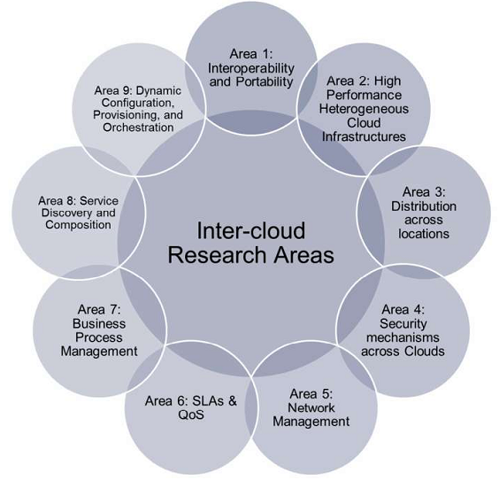
Inter-cloud research & challenges

Slide 6
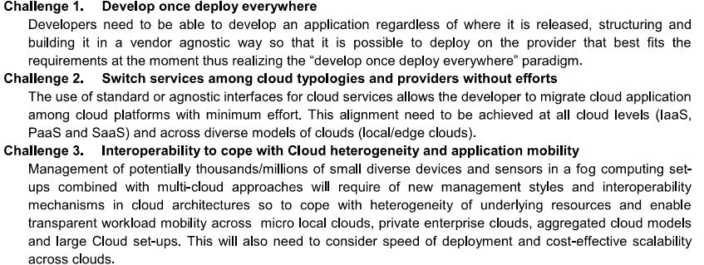
Research challenges-Area 1

Slide 7
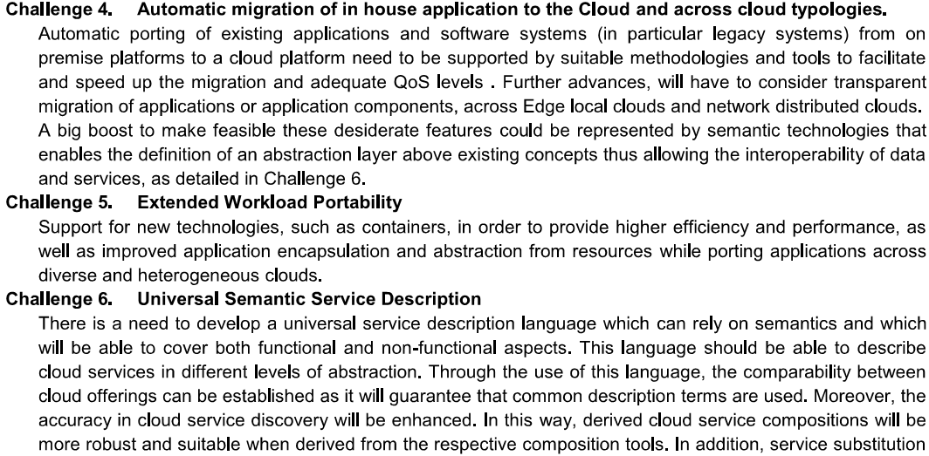
Research challenges

Slide 8
Area-2: heterogeneous cloud
Enable with Inter-cloud service provider connectivity
Monitor and guarantee inter-cloud infrastructure SLAs performance
Dynamic workload balancing in multi-cloud context
New programming paradigm for high performance computing
Dependability and reliability between cloud providers and consumers

Slide 9
Area-3: cloud federation
Scalability across cloud based on demand (EC2)
Cross-cloud VM/Container image distribution (migration)
High availably across hybrid clouds
Legal aspects

Slide 10
Area-4: security in the cloud
Security issues and security implementation – Chapter 7
Security mechanisms for Application integrity
Authentication in the federated cloud
Federated cloud authorization policies and use cases
Security and network aware application requirements
Audit ability of federated cloud networks

Slide 11
Area 5: Network Management
Federated inter and intra cloud networking
Faster communication among the IoTs and clouds
Dynamism in the heterogeneous cloud network setups
Ajile development and network software deployment and management

Slide 12
Area 6: SLA and QoS
SLA standard representation: uniformity
QoS and service layers monitoring
Intelligent brokering
SLA based service/application management

Slide 13
Area 7: Business Process Mgmt.
Smart Business to IT alignment, BPaaS
Cross layer and multi-level workflows and BPaaS
Cross Layer BPaaS monitoring and Adaptation
Intelligence of BPaaS across Cloud levels
Smart Business Intelligence through cross layer BPaaS
Flexible cost model

Slide 14
Area 8: Service Discovery and Composition
Automatic discovery and automation of services
Automatic API alignment and Software Defined

Slide 15
Area 9:Dyamic configuration, provisioning and orchestration of cloud resources
Cross layer cloud service negotiation
Cloud broker specialization to address vertical market needs
Multi-cloud application automation
Decentralized and autonomic management for multi-cloud
Orchestration and placement model/methods for distributed cloud

