Slide 1
Virtualization Technique
System Virtualization
Credit:

Slide 2
Agenda
Server Virtualization
Hypervisor??
Cloud Virtualization?
VMware on x86
Xen on x86
KVM on x86
ARMvisor on ARM
CPU virtualization
Memory virtualization
I/O virtualization

Slide 3
Server Virtualization
Virtualization means that Applications can use a resource without any concern for where it resides, what the technical interface is, how it has been implemented, which platform it uses, and how much of it is available.
Reason to virtualize
Sharing: Break up a large resource Large Capacity or high-speed E.g., Servers
Isolation: Protection from other tenants E.g., Virtual Private Network
Aggregating: Combine many resources in to one, e.g., storage
Dynamics: Fast allocation, Change/Mobility, load balancing, e.g., virtual machines

Slide 4
Advantages of Virtualization
Minimize hardware costs (CapEx) Multiple virtual servers on one physical hardware
Easily move VMs to other data centers
Provide disaster recovery. Hardware maintenance.
Follow the sun (active users) or follow the moon (cheap power)
Consolidate idle workloads. Usage is bursty and asynchronous. Increase device utilization
Conserve power Free up unused physical resources
Easier automation (Lower OpEx) Simplified provisioning - administration of hardware and software
Scalability and Flexibility: Multiple operating systems
• Enhanced utilization of resources
• Better availability for company applications • Lower maintenance costs • Lesser personnel needed for the IT department

Slide 5
Pitfalls of Virtualization
Pitfall 1: Failing to Track Virtual to Physical Communications
Managing across the physical and virtual domains is very Difficult–it requires “human” correlation.
The VM may have been used to test something and then was shut down or it may have been migrated to another server making it very difficult to know which virtual workloads are running on which physical servers.
Effective management of virtual environments requires a deeper understanding of the interplay between the physical and virtual environments

Slide 6
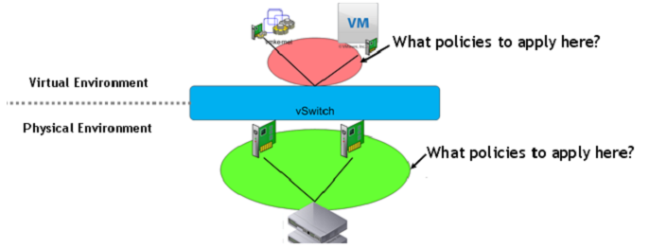
Pitfalls of Virtualization
Pitfall 2: Disregarding Critical Inter-VM Communications
Inter - VM communications are invisible to legacy management software and even most new management software.
Even VMware’s vCenter for managing individual VMs doesn’t show VM to VM communications.
The vSwitch spans both the virtual and physical environments

Slide 7
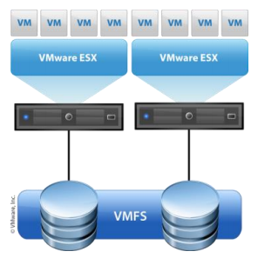
Pitfalls of Virtualization
Pitfall 2: Assuming IP Storage Configuration is “Plug and Play”
The ability to move a virtual workload creates a tremendous amount of flexibility for organizations. VM mobility allows IT departments to move a workload, in real time, in the event of a disaster, for maintenance purposes or for performance.
However, when the workload moves, network configurations and storage must adapt to the moving VM workload.
Establishing network configuration parameters that work properly in this environment is difficult.
Unfortunately mapping VMs to storage is extremely complex and the adoption of IP based storage is accelerating this complexity.
When a VM is moved, performance can suffer immensely and immediately due to a mis-configuration of storage resources for the new VM location.
Virtualization creates additional storage complexity – especially when VMs start moving…

Slide 8
Pitfalls of Virtualization
Pitfall 4: Keeping Status Quo Service management -Support Techniques
75% of problems are reported by end-users through the service desk, not having been detected by infrastructure management solutions.
No matter how big the cost savings is for a VM deployment, it can all be for naught if the end-user experience with their applications suffers.
If users are no longer able to do their jobs effectively because of poor application performance, the company will suffer

Slide 9
Pitfalls of Virtualization
Pitfall 5: Centering Focus only on Your VDI Ecosystem
If you are implementing VDI (virtual desktop infrastructure or just virtual desktops), you have to look beyond the ecosystem required to implement VDI to everything sharing anything with your VDI implementation.
Why? Because your end-users’ desktop experience is over a shared infrastructure – and their experience will be impacted by everything communicating on that shared infrastructure.
VDI splits an end-user desktop into three or more distinct entities – all of which can be adversely affected by something unexpected.
The monitor and thin client on a physical network that you interact with
The virtual desktop (VM ) in a data center running the desktop OS and office type applications
The network storage array which stores the files of data that used to be on your desktop and are now separate from the VM
These three entities communicate with each other over your shared network – continuously – with potentially disastrous results due to resource conflicts.

Slide 10
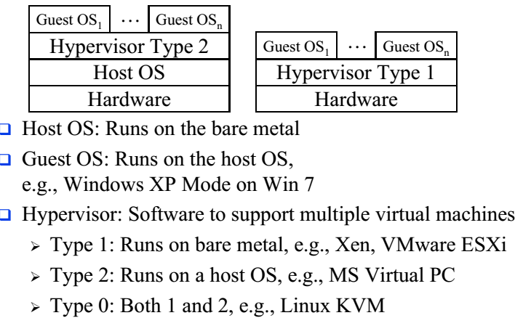
Virtualization Concept

Slide 11
Level of Virtualization
User Virtualization
Application Virtualization
Desktop Virtualization
Service Virtualization
OS Virtualization
Server Virtualization
Storage Virtualization
Network Virtualization

Slide 12
OS Virtualization
Multiple isolated user spaces on the same operating system
Multiple users can remotely login and use the system. Only one operating system instance
Guest operating system is similar or same as the host E.g., Windows on Windows
Applications of one user cannot affect other users aka Jails => Can be used to run suspect software E.g., iCore Virtual Accounts and Sandboxie

Slide 13
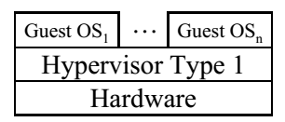
Desktop Virtualization
A Desktop system with multiple operating systems. Example: Mac OS X and Windows at the same time Parallels Desktop for Mac
Hypervisor type 1 similar to server virtualization
Useful for testing software on multiple OS
Reduced hardware cost
This is local desktop virtualization

Slide 14
Client Virtualization (thin client)
Also called Remote Desktop Virtualization or Virtual Desktop Infrastructure (VDI or Access Virtualization
Remote server provides most of the computing and storage resources
All programs and data is stored on remote servers
Local computer is simple with limited resources
Easy maintenance and upgrades
Users can log in on any client
Significant energy savings. Example: Chrome books, Zero Client: Power cable only. USB and communication via WiFi

Slide 15
Application VIrtualization
Allows an application to run on many different operating systems and hardware
Application byte code can run on different processors and operating systems usually using an interpreter or just-in-time (run-time) compilation. Examples: Java Virtual Machine (JVM)

Slide 16
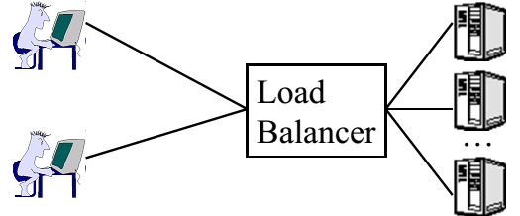
Service Virtualization
Service is similar to but different from applications in that they are hidden from the end user. Example services: Firewall, load balancer, Proxy Server
Service virtualization: Virtual appliances implemented in software.
A load balancer’s IP address is advertised outside. It distributes the load to multiple servers.

Slide 17
User Experience Virtualization
Aka User Virtualization.
Users see the same application interface regardless of the device: laptop, tablet,Smart Phone.
Users can roam from device to device
User profiles and application settings are stored in a central data center or cloud. Example: Microsoft UE-V

Slide 18
Parallel Virtual Machine
One computing environment running on multiple computers.
PVM is also the name of an open source software that allows running a program in parallel on multiple machines.
Now grid computing and cluster computing is generally used.
Para-Virtualization
Hypervisor offers special APIs for operations that are difficult to run in a virtual environment
Requires modifying the guest OS. Requires source code for the guest OS. Change and recompile for the hypervisor.
Example: paravirt-ops code in Linux provides a hypervisor agnostic interface between the hypervisor and guest kernels.

Slide 19
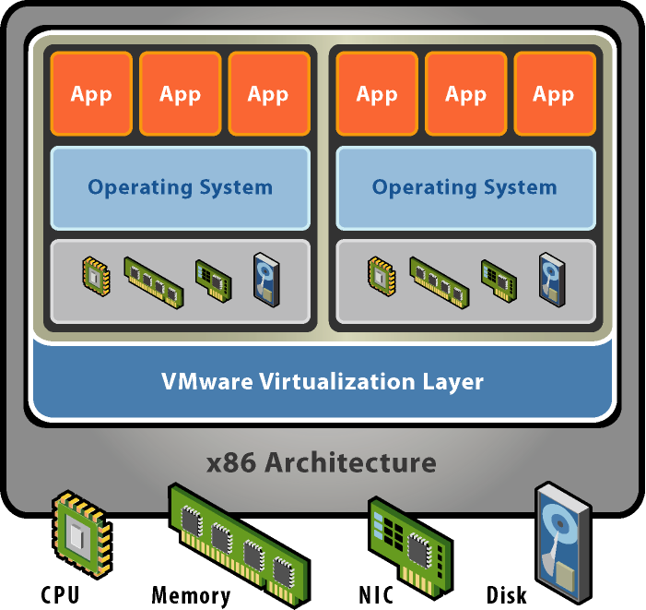
VMware
Basic properties :
Separate OS and hardware – break hardware dependencies
OS and Application as single unit by encapsulation
Strong fault and security isolation
Standard, HW independent environments can be provisioned anywhere
Flexibility to chose the right OS for the right application

Slide 20
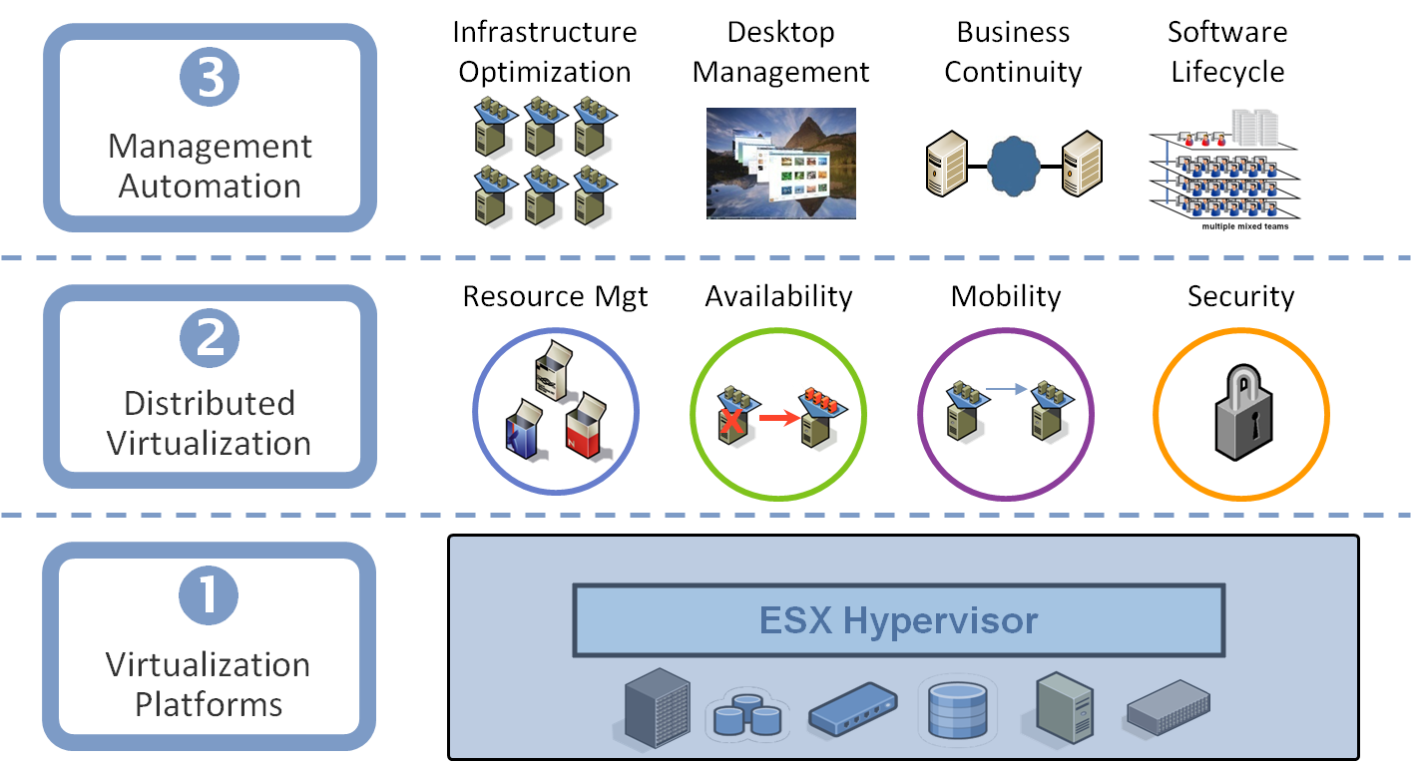
VMware Virtualization Stack

Slide 21
VMware Major Products
VMware Server
A free-of-charge virtualization-software server suite
Run multiple servers on your server
Hosted architecture
Available for Linux hosts and Windows hosts
VMware ESX Server
An enterprise-level computer virtualization product
Quality of service
High-performance I/O
Host-less architecture ( bare-metal )

Slide 22
VMware GSX Server Architecture

Slide 23
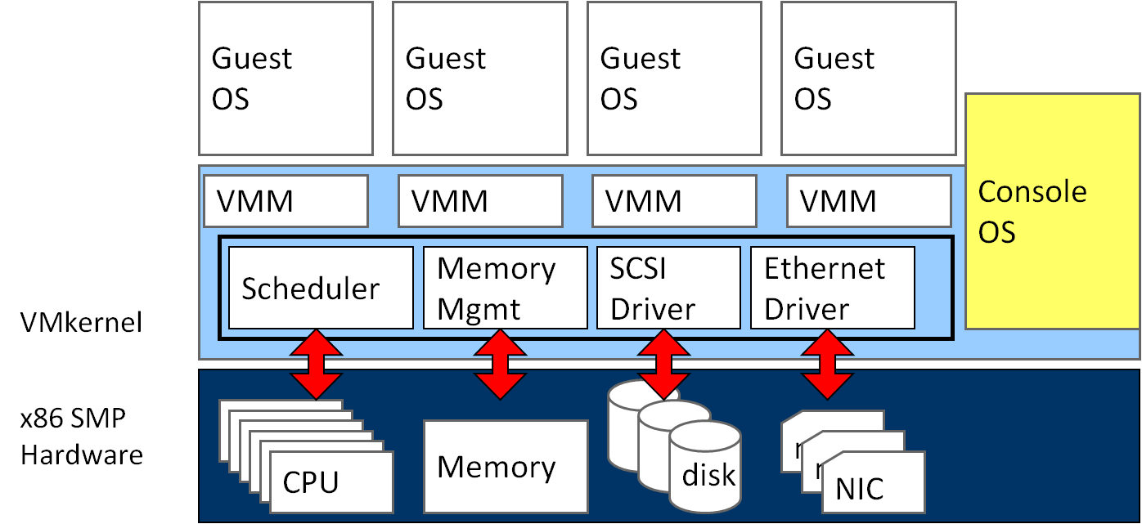
VMware ESX Server Architecture
Notes:
SMP: symmetric multiprocessing

Slide 24
Xen
Basic properties :
Para-virtualization
Achieve high performance even on its host architecture (x86) which has a reputation for non-cooperation with traditional virtualization techniques.
Hardware assisted virtualization
Both Intel and AMD have contributed modifications to Xen to support their respective Intel VT-x and AMD-V architecture extensions.
Live migration
The LAN iteratively copies the memory of the virtual machine to the destination without stopping its execution.
Implement system:
Novell's SUSE Linux Enterprise 10
Red Hat's RHEL 5
Sun Microsystems' Solaris

Slide 25
Original Xen Architecture

Slide 26
Hardware Assistance in Xen
Hardware assistance :
CPU provides VMExit for certain privileged instructions
Extend page tables used to virtualize memory
Xen features :
Enable Guest OS to be run without modification
For example, legacy Linux and Windows
Provide simple platform emulation
BIOS, apic, iopaic, rtc, Net (pcnet32), IDE emulation
Install para-virtualized drivers after booting for high-performance IO
Possibility for CPU and memory para-virtualization
Non-invasive hypervisor hints from OS

Slide 27
KVM
KVM ( Kernel-based Virtual Machine)
Linux host OS
The kernel component of KVM is included in mainline Linux, as of 2.6.20.
Full-virtualization
KVM is a full virtualization solution for Linux on x86 hardware containing virtualization extensions.
Using KVM, one can run multiple virtual machines running unmodified Linux or Windows images.
IO device model in KVM :
KVM requires a modified QEMU for IO virtualization framework.
Improve IO performance by virtio para-virtualization framework.

Slide 28
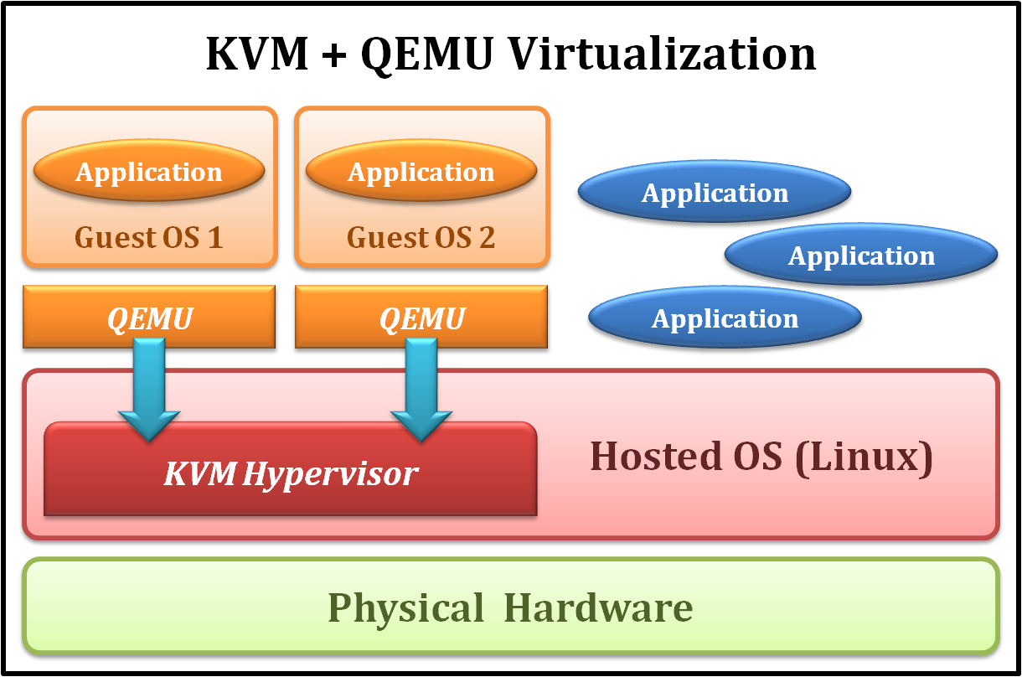
KVM Full Virtualization
It consists of a loadable kernel module
kvm.ko
provides the core virtualization infrastructure
kvm-intel.ko / kvm-amd.ko
processor specific modules

Slide 29
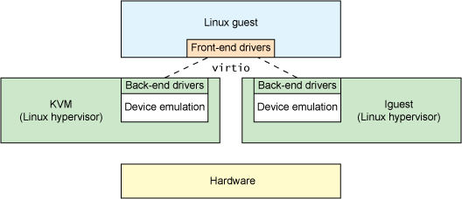
IO Device Model in KVM
New approach with para-virtualization

Slide 30
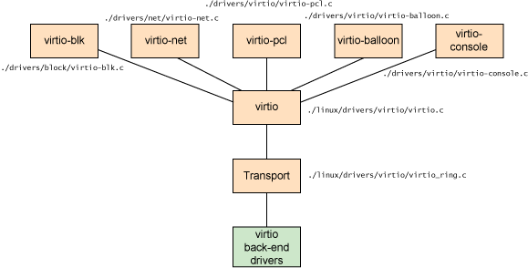
IO Device Model in KVM
virtio architecture

Slide 31
UND
ABORT
SWI
IRQ/FIQ
KVM Trap Entry
Host Trap Handler
KVM/Guest
Context Switch
Unit
KVM Trap Dispatcher
Instruction Emulation
MMU Emulation
Exception/Interrupt Emulation
QEMU I/O
Emulation

Slide 32
CPU Virtualization Overhead
CPU virtualization
Frequent lightweight traps result in lots of context switch
Try to reduce…
number of traps
Overhead of emulation
Notes:
In our measurement, parts of critical instructions only involve in virtual state and no hardware modification is needed.
As a result, instead of trapping such instructions, we have an idea that let these instructions execute in guest address space.
Other parts of sensitive instructions must be executed in privileged mode, that is, it must be trapped to host when emulation. The optimization policy of CPU virtualization is to reduce the number of traps and the overhead of emulation.

Slide 33
CPU Optimization Methods
Operations that read the information in co-processor are replaced by SRFA (shadow register file access).
TLB (Translation Lookaside Buffer) operations and BTB (Branch Target Buffer) flush in guest are replaced by NOP.
FIT (fast instruction trap) is applied to reduce costs of context switch.

Slide 34
TLB/Cache Trap Optimization
Originally, the instruction emulation path is too long!
Hypervisor
Guest
Enter System Mode
TLB and Cache
Instructions
Assembly
Code
Trap
Context Switch
Handler
Dispatcher
C
Sensitive Instruction
Emulation Engine
TLB/Cache Instruction Emulation

Slide 35
TLB/Cache Trap Optimization
After optimization, the overhead of TLB/Cache trap is reduced
Hypervisor
Guest
Enter System Mode
TLB and Cache
Instructions
Assembly
Code
Trap
Fast Emulation
Engine
Notes:
translation lookaside buffer - TLB

Slide 36
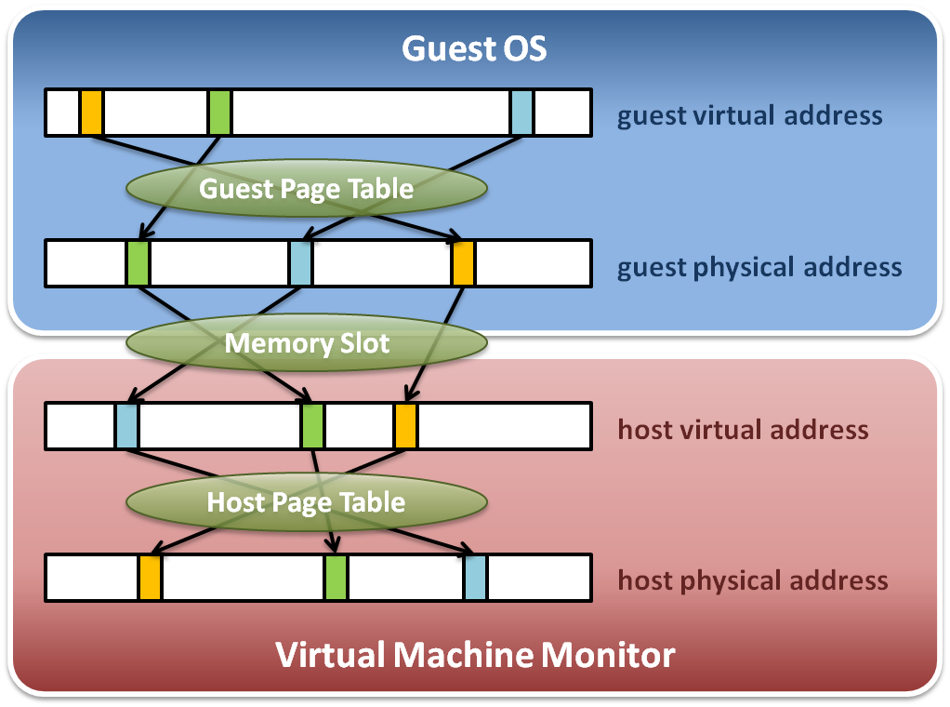
Memory Virtualization on X86
Memory virtualization architecture

Slide 37
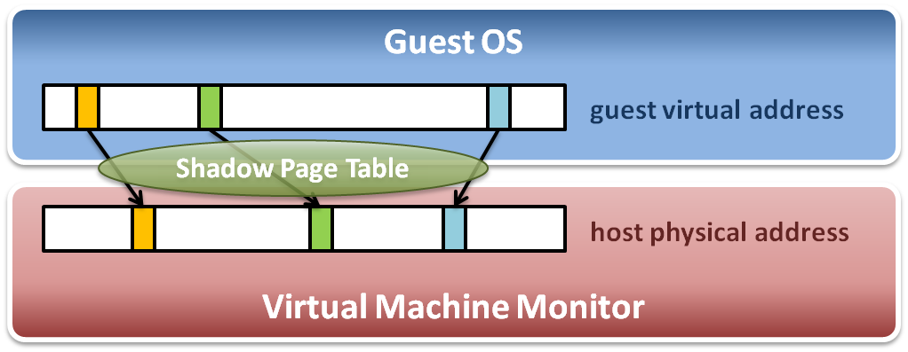
Memory Virtualization on X86
The performance drop of memory access is usually unbearable. VMM needs further optimization.
VMM maintains shadow page tables :
Direct virtual-to-physical address mapping
Use hardware TLB for address translation

Slide 38
Dynamic Physical Memory Allocation to Guest
Host
Virtual
Memory
Guest
Physical
Memory
Host
Physical
Memory
Guest physical memory pages are allocated dynamically at runtime.

